Slide 1



Combatting Tax Identity Theft
PRESENTED BY:
TaxLock LLC

Slide 2


Tax ID Theft
How Pervasive is This Threat
Online and virtual identity theft is again on the rise
Just two years ago, the United States Postal Service (USPS) revealed that it had suffered a data breach. More than 800,000 employees were impacted in the scheme.
CNN, citing a U.S. official familiar with the breach, said 2.9 million postal service customers were also affected by the breach. Potentially compromised customer details include names, addresses, telephone numbers and e-mail addresses.
Sadly, these are no longer isolated cases, but rather a pattern of malicious behavior by bad actors, often facilitated by murky organizations and even hostile countries.
Initial Data Model Testing Started 07/10/2017
Data Cleanup Started 07/10/2017
4)
Notes:
Online and ID Theft is on the rise
All it takes is one online retailer taking their eye off the cybersecurity ball for your personal information to wind up in nefarious hands
There are numerous categories of cyber crime, but the ones that affect the most victims include identity theft, credit card fraud, and social networking scams.
The security breach on the Office of Personnel Management in 2015 exposed the personally identifiable information of 21.5 million Americans, including 4.2 million federal employees.
2.9 million postal service customers were also affected by the breach. Potentially compromised customer details include names, addresses, telephone numbers and e-mail addresses
On the tax side, one of the most damaging ID theft attacks that recently affected taxpayers occurred when an automated IRS service was breached and millions of tax records went missing.
Sadly, these are not isolated cases, but rather a pattern of malicious behavior by bad actors, often facilitated by murky organizations and even hostile countries.
No matter how careful you are, it’s pretty much impossible to completely erase the threat of cyber fraud.

Slide 3


Tax ID Theft
Cybersecurity Assessment
The threat is real!
National Security Agency has published information on Threat Assessment and Mitigation
Some of the key findings from the U.S. Department of Justice*
  17.6 million American or 7% of 16 years or older were victims
  86% experienced misuse of an existing credit card or bank account
  7% experienced multiple types of identity theft
  14% of identity theft victims experienced an out of pocket loss
  14% lost $1,000 or more
Initial Data Model Testing Started 07/10/2017
Data Cleanup Started 07/10/2017
4)
*U.S. Department of Justice, “Victims of Identity Theft (Revised 2017)” report (Source: https://www.bjs.gov/content/pub/pdf/vit14.pdf):
Notes:
NSA and DOJ recently did a study on Cyber theft
Some of the key findings from the U.S. Department of Justice*
17.6 million American or 7% of 16 years or older were victims
86% experienced misuse of an existing credit card or bank account
14% of identity theft victims experienced an out of pocket loss
14% of those lost $1,000 or more

Slide 4



Tax ID Theft
Tax Specific Identity Theft
We always urge extreme caution with any financial aspects of our lives
The goal behind this presentation is to address Identity Theft schemes that, over the last seven years, have crept into the annual tax filing process and wreaked havoc on taxpayers and tax practitioners alike.
The IRS has reported that the number of tax returns with confirmed identity theft was 649,000 in 2018, 597,000 in 2017, and a staggering 883,000 in 2016
Though the individual cases processed by the IRS have declined, the number of phishing scams more than doubled in 2018 vs. 2017. And the scams are getting more and more sophisticated with each year.
Initial Data Model Testing Started 07/10/2017
Data Cleanup Started 07/10/2017
4)
Notes:
The goal behind this presentation is to address Identity Theft schemes that, over the last seven years, have crept into the annual tax filing process and wreaked havoc on taxpayers and tax practitioners alike.
The IRS has reported that the number of tax returns with confirmed identity theft was:
649,000 in 2018
597,000 in 2017
and a staggering 883,000 in 2016
The number of phishing scams more than doubled in 2018 vs. 2017
And the scams are getting more and more sophisticated with each year.

Slide 5


Tax ID Theft
Two Main Types of IRS Fraud
There are two types of IRS fraud:
One is achieved through impersonation of Internal Revenue or United States Treasury employees
The other is the exact reverse, i.e. impersonating the taxpayer by filing a fraudulent tax return with the IRS, using the taxpayer’s correct Social Security number, name and date of birth, but fake home address and/or bank account number and fake credits
Initial Data Model Testing Started 07/10/2017
Data Cleanup Started 07/10/2017
4)
Notes:
To understand IRS fraud, it is important to understand the distinction between two exactly opposite types of IRS fraud:
achieved through impersonation of Internal Revenue or United States Treasury employees
impersonating the taxpayer by filing a fraudulent tax return with the IRS, using the taxpayer’s correct Social Security number, name and date of birth, but fake home address and/or bank account number and fake credits

Slide 6
Tax ID Theft
Type 1 (Impersonation)
First is when scammers try to impersonate an IRS agent of officer in an effort to extort money from the victim. Typically, you would get a phone call or an email, purportedly from the IRS saying that you owe taxes and must pay them or else.
Of course, most of these are obvious tricks, but sometimes people still get conned, especially when a ruse is set up with enough sophistication.
These scammers have been perfecting their trade and what started as Unknown Caller ID VOIP calls and emails in broken English progressed to some very believable emails or calls.
These are now frequently facilitated by Americans without a trace of an accent calling from a 202 area code, or emailing from what appear on the surface to be legitimate government email accounts with stolen IRS logos and graphics.
Initial Data Model Testing Started 07/10/2017
Data Cleanup Started 07/10/2017
4)
Notes:
Here are the most common example of the first type:
Scammers try to impersonate an IRS agent of officer in an effort to extort money from the victim. Typically, you would get a phone call or an email, purportedly from the IRS saying that you owe taxes and must pay them or else.
Of course, most of these are obvious tricks, but sometimes people still get conned, especially when a ruse is set up with enough sophistication.
These scammers have been perfecting their trade and what started as Unknown Caller ID VOIP calls and emails in broken English progressed to some very believable emails or calls.
These are now frequently facilitated by Americans without a trace of an accent calling from a 202 area code (which most East Coast residents recognize as Washington DC), or emailing from what appear on the surface to be legitimate government email accounts with stolen IRS logos and graphics.
Who is an intended victim? Naturally, you would think it’s a frail retired citizen with a high school degree and a history of blue collar jobs.
You will be surprised to learn that a lot of times it would be a very sophisticated taxpayer. There have multiple CEO/CFO types, including some people with advance degrees, i.e. CPAs and even attorneys, that fell for these tricks

Slide 7
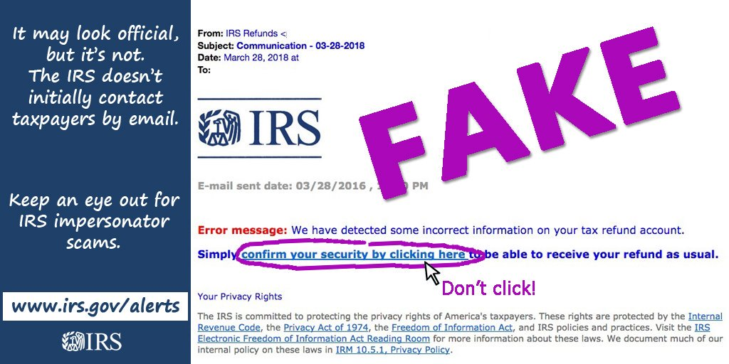

Tax ID Theft
Common Wisdoms on Communications – Identifying the Fakes
It is worth reiterating, however, that the Internal Revenue Service NEVER communicates by electronic mail
IRS NEVER initiates contact by telephone
Additionally, the IRS NEVER attempts to collect its debt through debit cards, PayPal, wire transfers, etc.
Initial Data Model Testing Started 07/10/2017
Data Cleanup Started 07/10/2017
4)
Notes:
The most important lesson to remember is that Internal Revenue Service NEVER communicates with taxpayers by electronic mail
IRS NEVER initiates contact by telephone
IRS NEVER attempts to collect its debt through debit cards, PayPal, wire transfers, etc.
There are rare exceptions, mostly limited to tax practitioners. For example:
IRS officers in appellate division have more flexibility, and it is more likely some CPAs and tax attorneys will be able to email them
Chief Counsel office may choose to communicate with Power of Attorney representatives licensed to practice before Tax Court and file a petition with TC. However, these are rather exceptions than rules, and usually limited to certain practitioners
Otherwise, it is almost impossible for taxpayers to obtain an email address of an IRS agent. And certainly no communication will be initiated via email, even with a tax practitioner

Slide 8
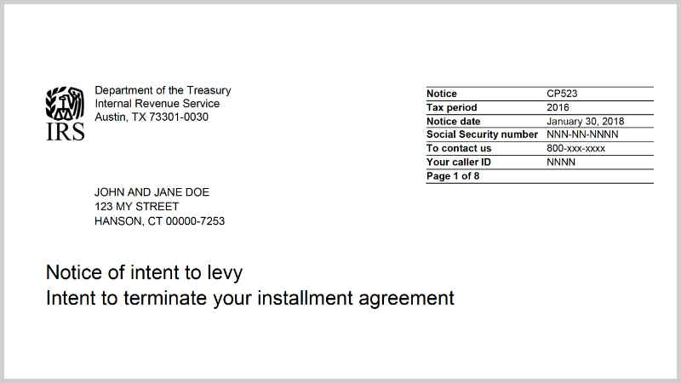

Tax ID Theft
Common Wisdoms on Communications – Real IRS
Procedurally, there would be multiple communications from Internal Revenue, under the Collections Due Process, before a debt can be considered enforceable
And even then, all collections efforts are still undertaken by government mail, not emails or phone calls
The statutory rules require that all taxpayer contact from the government be initiated by First-Class mail
Initial Data Model Testing Started 07/10/2017
Data Cleanup Started 07/10/2017
4)
Notes:
The statutory rules require that all taxpayer contact from the government be initiated by First-Class mail
Procedurally, there would be multiple communications from Internal Revenue, under the Collections Due Process, before a debt can be considered enforceable
And even then, all collections efforts are still undertaken by government mail, not emails or phone calls
Recently, there has been a change that allows enforcement by personal visit for habitually delinquent “high income” taxpayers. In that case, an officer might establish a face-to-face contact
Under any scenario, no enforcement action will ever happen when a person on the phone will ask a taxpayer for private banking or financial information

Slide 9
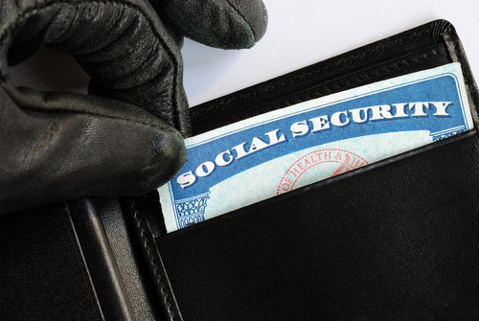


Tax ID Theft
Type 2 (What TaxLock was created to fight)
The second type is a tax-related identity theft, which occurs when someone uses your stolen Social Security number (SSN) to file a tax return claiming a fraudulent refund
You may be unaware that this has happened until you or your CPA tries to e-file your return and discover that a return already has been filed using your SSN
Or, the IRS may send you a letter saying it has identified a suspicious return using your SSN.
Initial Data Model Testing Started 07/10/2017
Data Cleanup Started 07/10/2017
4)
Notes:
This second and more dangerous type of fraud started many years ago, as far back as late 1990s, but it did not reach the pandemic status until 2011-2013
Occurs when someone uses your stolen Social Security number (SSN) to file a tax return claiming a fraudulent refund
In most cases, a taxpayer is unaware that this has happened until she or her CPA tries to e-file your return and discover that a return already has been filed using her SSN
Or, the IRS may send the taxpayer a letter saying it has identified a suspicious return using her SSN.
All previous fighting mechanisms that were used were reactive in nature
Thankfully, we finally can fight back and PREVENT THIS FRAUD

Slide 10

Tax ID Theft
The mechanics of fraud
What usually happens is that fraudsters acquire victim’s information (SSN, name and address) on the dark web, usually in bulk
Then they file a victim’s return very early in the tax season, using the correct social and name, but a fake address and fake federal tax credits to claim fraudulent refunds
Initial Data Model Testing Started 07/10/2017
Data Cleanup Started 07/10/2017
4)
Notes:
A bit about the mechanics of this cybercrime, which will help us understand how to immediately recognize it.
What usually happens is that fraudsters acquire victim’s information (SSN, name and address) on the dark web, usually in bulk
Then they file a victim’s return very early in the tax season, using the correct social and name, but a fake address and fake federal tax credits to claim fraudulent refunds

Slide 11


Tax ID Theft
The mechanics of fraud (continued)
Sometimes the fraudsters would request a physical check to be mailed to that fake address
In other cases, they would set up burner bank accounts for a quick direct deposit
And when the victim tries to file his or her legitimate return with the IRS, the government rejects the filings as “duplicate”
Initial Data Model Testing Started 07/10/2017
Data Cleanup Started 07/10/2017
4)
Notes:
What happens next?
Sometimes the fraudsters would request a physical check to be mailed to that fake address. Fake addresses can be the criminal’s own home, PO Box, or an abandoned/foreclosed home that is used as a “conduit address”. In extreme cases, it could be another unsuspecting person’s residence, where their mailbox is being monitored for USPS mail delivery, with the criminals “sweeping” the mailbox immediately after the mailman leaves. This scheme is very sophisticated and involves well-funded and structurally operated crime syndicates, typical of organized crime.
In other cases, they would set up burner bank accounts for a quick direct deposit. Once the refund (or multiple refunds) is deposited into that account, the illegally obtained funds get swiped out to another account in a safe haven foreign jurisdiction and the account closed within days. If, or when, the IRS or Treasury investigators track down the refunds they now know to be fraudulent, and discover where the money went, there is nothing there and the trace grew cold.
What is the price we all pay?
The victim tries to file his or her legitimate return with the IRS, the government rejects the filings as “duplicate”
In cases where the fake return was successful, the criminals got away with the money. The IRS will then be looking to reclaim that fraudulent refund from the real taxpayers once the fraud is discovered. It will take a long time to get out of the obligation to return the money someone else stole using your identity
But even if the IRS was savvy enough to recognize a potential fraud, it could take months, even years in some cases, to fix an affected account in the government computer system

Slide 12




Tax ID Theft
Combatting the Enemy
There have been some enhancements to this taxpayer vulnerability in the last two years
The banks started to cooperate better with the US Treasury and are able to intercept a large number of refunds going to burner accounts
IRS has come up with procedures how to minimize the risk of fraudulent tax returns
Pilot program for IP PINs
Initial Data Model Testing Started 07/10/2017
Data Cleanup Started 07/10/2017
4)
Notes:
The IRS as well as the tax preparer community has been actively fighting this menace since 2015. Outreach programs have been developed to educate consumers, as well as tax practitioners of this danger.
There have been some enhancements to this taxpayer vulnerability in the last two years
The banks started to cooperate better with the US Treasury and are able to intercept a large number of refunds going to burner accounts, especially if the same account is used for multiple refunds
IRS has come up with procedures how to minimize the risk of fraudulent tax returns
Pilot program for IP PINs has been enhanced
There are some unintended consequences to this extra vigilance:
inability to deposit refunds to parent accounts, in cases where legitimate households may be sharing the same account, i.e. minor children’s investment income triggers tax obligations and sometimes parents request refunds to de deposited into their account
Practitioners have to respond to numerous letters where IRS identifies a submission as potentially fraudulent, even though it was a legitimate tax return
Sometimes it becomes a theater of absurd. Some CPAs had to authenticate returns that were flagged by the IRS as suspect, where there were no refunds sought, but rather a large tax obligation was incurred and money was paid. It is not known how the IRS algorithm for catching fraudulent submissions operates, but it should not, under normal circumstances, identify large 100-page tax filings as ID thefts. In almost all cases, fraudulent tax returns involve a simple 5-page filing asking for a refundable earned-income-tax credit

Slide 13
Tax ID Theft
The Evolution of IP PINs
Most importantly, IRS allows residents of most targeted jurisdictions to request an Identity Protection number (a so called IP PIN).
The initial “pilot” states in 2014 were Florida, Georgia and District of Columbia
The highest concentration of ID theft
Starting with tax year 2018, the IRS has added seven additional states: California, Delaware, Illinois, Maryland, Michigan, Nevada, and Rhode Island
Starting with the 2020 filing season, 10 additional states were added to the list: Arizona, Colorado, Connecticut, New Jersey, New Mexico, New York, North Carolina, Pennsylvania, Texas and Washington
To date, this is the most efficient tool in the battle against Tax ID theft
If you have clients who are residents of any of these high-risk states, it is probably malpractice to not at least educate them about this option
Initial Data Model Testing Started 07/10/2017
Data Cleanup Started 07/10/2017
4)
Notes:
The most effective tool to combat IRS ID Theft has always been IP PIN
Until very recently, you had to be an existing victim, or potential victim, of tax ID theft to participate in this program
This was not very helpful, as a reactive measure it did not really help taxpayers prevent the future cyber crime
There was a “pilot” program set up in 2013, which allowed non-affected taxpayers from certain jurisdictions to apply for an IP PIN
The initial “pilot” states were Florida, Georgia and District of Columbia. The reason for singling out those three - highest concentration of ID theft
Starting with tax year 2018, the IRS has added seven additional states: California, Delaware, Illinois, Maryland, Michigan, Nevada, and Rhode Island
Starting with the 2020 filing season, 10 additional states were added to the list: Arizona, Colorado, Connecticut, New Jersey, New Mexico, New York, North Carolina, Pennsylvania, Texas and Washington
As of today, more than 50% of US population live in the area covered under the voluntary IP PIN program
If you have clients who are residents of any of these high-risk states, it is probably malpractice to not at least educate them about this option
If you or your clients reside in the other 31 states, you need to be proactive and ask your elected representative to nudge the IRS in the right direction and expand the program to their jurisdiction
The Congress has passed a law in 2019 requiring the IRS to expand IP PINs to the whole country by 2025
However, we can’t afford to wait another 5 years. The time is now to make it available to all US taxpayers regardless of where they reside
TaxLock LLC has undertaken efforts, through lobbying members of the Congress and educating tax practitioners, to help eradicate this type of cyber crime once and for all
We are in the process of creating a nationwide network of crime fighters, i.e. CPAs’, EA’s, attorneys, financial planners, etc.
It is called TITEN, or tax identification theft eradication network. We want all taxpayers to be at least given an opportunity to enroll in the IP PIN program. This can only be achieved through community outreach and CPA-led efforts to educate their clients

Slide 14
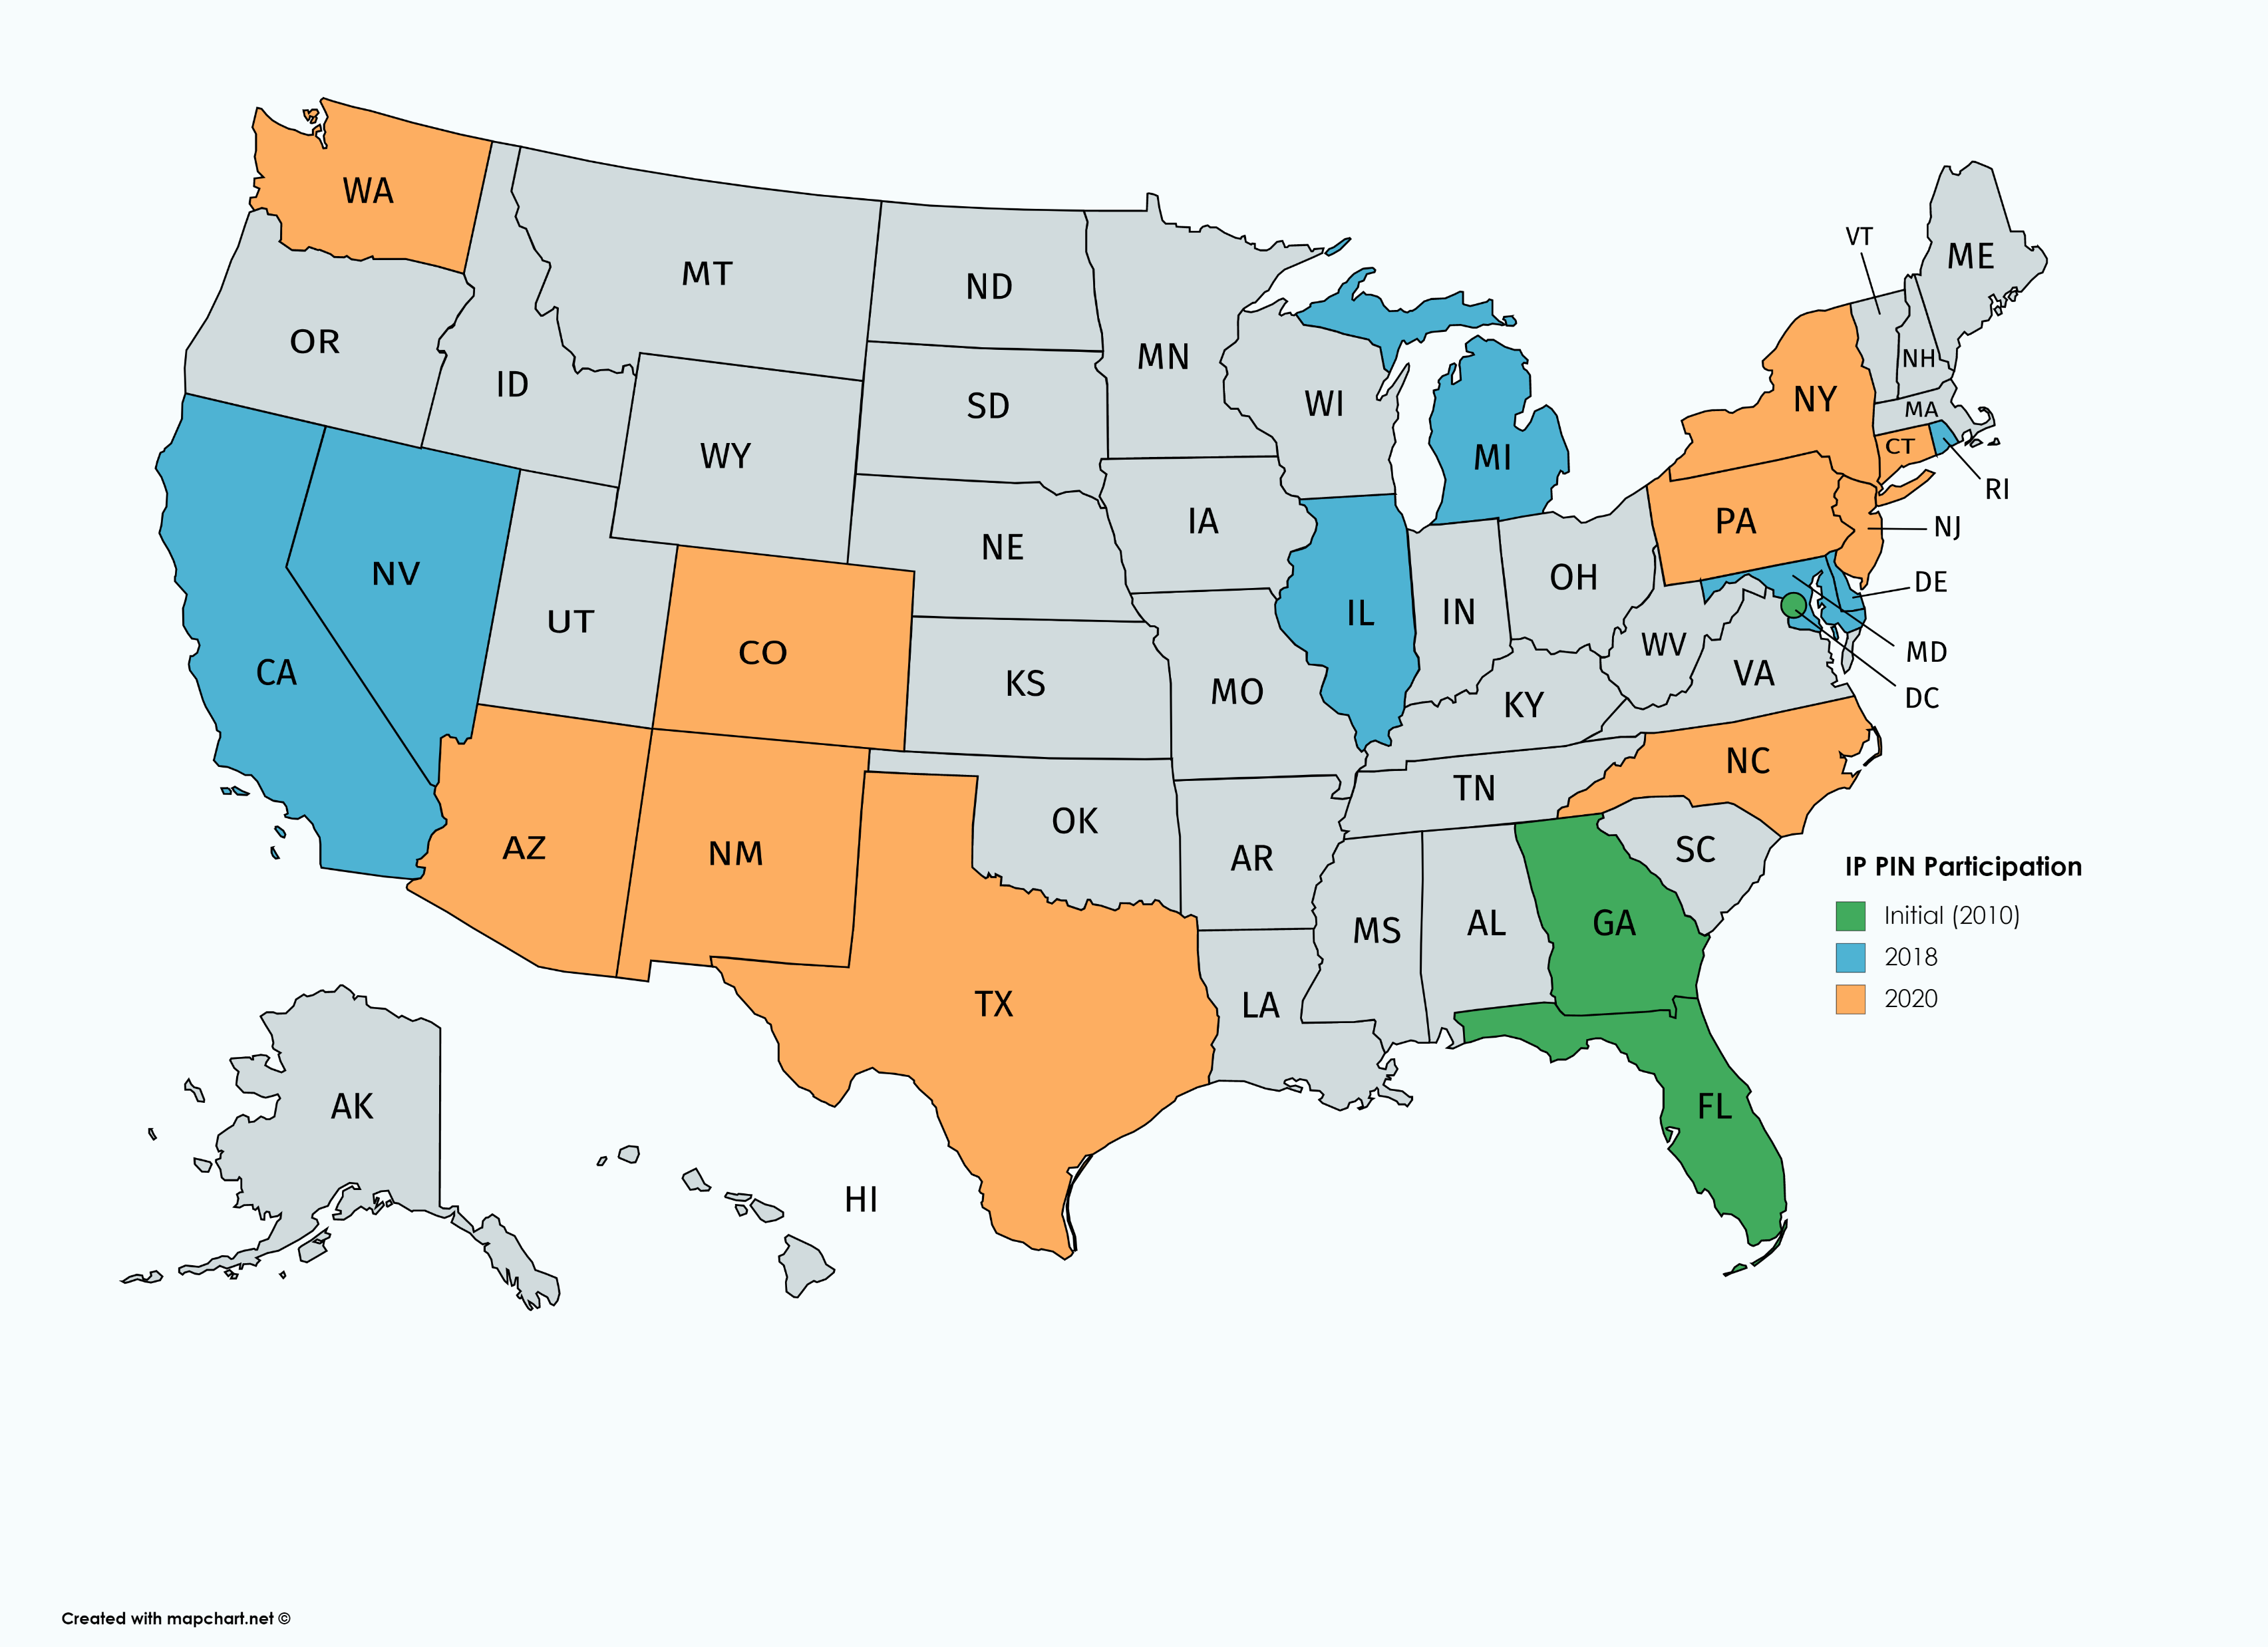
Tax ID Theft
The Evolution of IP PINs (Map)
Notes:
This is the map of the states currently participating in the IP PIN programs
We have two big goals now”
We hope, with your help, to persuade the federal government to afford residents of all currently gray states the same level of protection as those 20 that are currently a part of the program
To make sure all taxpayers residing in orange, blue and green states know that they have an option to proactively protect themselves from the IRS tax theft
In the end, each taxpayer will make their own decision. Some may choose not to enroll, and this is fine too. But it’s incumbent upon us the tax professionals to at least present the options
At this point, most taxpayers, even those living in the approved jurisdictions, have no idea they can enroll in IP PINs. Even in those three states that were added six years ago, an overwhelming majority of residents are not aware of the protection awarded them by the federal government.

Slide 15
Tax ID Theft
How to Get IP PINs
A 6-digit number that changes every year
Once assigned, you MUST use the IP PIN to file your returns
There is no way out of the program, which makes sense. Otherwise, it would defeat the very purpose of its existence
Can be retrieved online in mid-January
The initial IP PIN can be requested online
Taxpayers requesting an IP PIN will need to complete the IRS’s secure access identity verification process in order to be admitted to the program
Current interface may be challenging to some taxpayers, particularly the elderly or less technologically savvy consumers
Will likely need professional help to finalize the initial enrollment
Initial Data Model Testing Started 07/10/2017
Data Cleanup Started 07/10/2017
4)
Notes:
IP PIN is a 6-digit number that changes every year
Once assigned, you MUST use the IP PIN to file your returns
There is no way out of the program, which makes sense. Otherwise, it would defeat the very purpose of its existence, since it open it up for manipulation
IP PINs get mailed every year and can be retrieved online in mid-January
The initial IP PIN must be requested online. The process may be finalized online at the same time for some taxpayers. For those whose identity cannot be fully validated by matching cell phone number with provider information will need to enroll in two stages
Taxpayers requesting an IP PIN will need to complete the IRS’s secure access identity verification process in order to be admitted to the program
Current interface may be challenging to some taxpayers, particularly the elderly or less technologically savvy consumers
Some taxpayers will likely need professional help to finalize the initial enrollment, i.e. CPA, EA, financial planner

